Slide 1
COMP1003 – Algorithms, Data Structures & Maths Session 10 Vectors and Matrices
Thomas Wennekers
University of Plymouth

Slide 2
Coordinates and Vectors

Slide 3
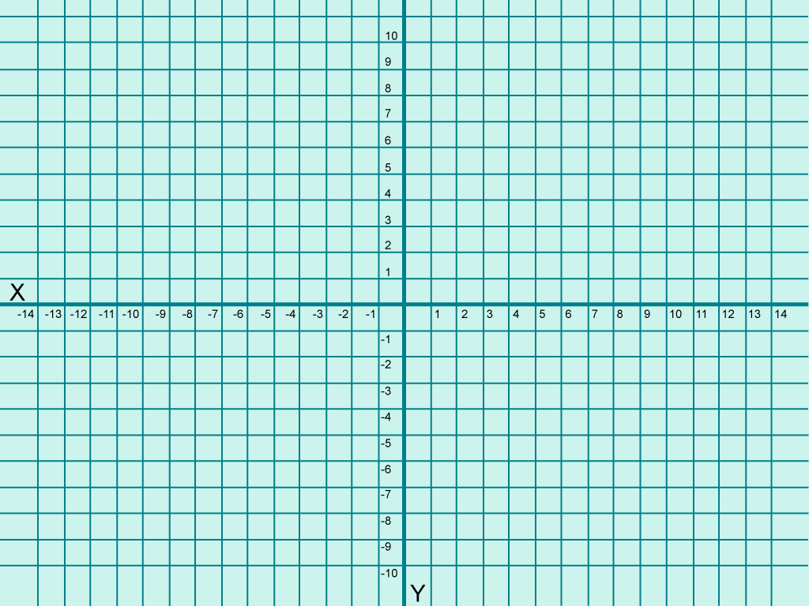
Cartesian co-ordinates of a point are represented by an (X, Y) pair
(-3, 4)
(6, 4)
●
●
(-8, 0)
●
●
●
(-7, -5)
(4, -5)

Slide 4
Vectors
In contrast, a scalar has magnitude but no direction
A vector comprises a magnitude and direction and can be depicted by an arrow
A vector can be thought of as a movement
The magnitude of the vector is the length of the arrow
In 2D we could represent a vector by its horizontal (X) and vertical (Y) displacements

Slide 5
Vectors
In 2D we could represent a vector by its X and Y displacements: here it is [a, b]
Notice here that [a, b] represents a displacement – not a point in/on the plane
However – if we draw the vector [a, b] starting at (0, 0), it will end at the point (a, b)
b
a

Slide 6
Vectors have magnitude and direction … but not location
Both of these arrows represent the same vector, i.e., [6, 3]
●

Slide 7
Negating a vector
-[a, b] = [-a, -b]
[a, b]
b
a
-[a, b]
Same magnitude; opposite direction

Slide 8
Multiplying a vector by a scalar
2 [a, b] = [2a, 2b]
b
a
Same direction; twice as far
2b
2a

Slide 9
Vector addition
[a, b] + [c, d] = [a+c, b+d]
[a+c, b+d]
d
c
b
a
Addition corresponds to one movement followed by another. Note that as usual, addition is commutative, i.e., [a, b] + [c, d] = [c, d] + [a, b]

Slide 10
Vector subtraction
[a, b] - [c, d] = [a-c, b-d]
[a, b] - [c, d] = [a-c, b-d] is the vector which when added to [c, d] yields [a, b]
c
d
b
[a-c, b-d]
a

Slide 11

Vector subtraction
Subtraction is the addition of the negative
[a, b] - [c, d] = [a-c, b-d] = [a, b] + (-[c, d])
-[c, d]
b
[a-c, b-d]
a
[c, d]

Slide 12
Vector magnitude
Let v = [a, b], then the magnitude of v is the length of the arrow
│v│ = √(a² + b²)
[a, b]
b
a
v is a unit vector if │v│=1
Unit vectors can be used to represent direction
For any non-zero vector v if k = 1/│v│, then kv is the unit vector pointing in the same direction as v
E.g., if v = [3, 4], then │v│=5. If k=1/5, then kv = [3/5, 4/5] is parallel to v and has magnitude 1

Slide 13
The triangle inequality
Let v = [a, b] and w = [c, d], then
│v + w│ ≤ │v│ + │w│
[a+c, b+d]
d
i.e., the shortest path between two points
is the straight line joining them
c
b
a

Slide 14
The scalar product
The scalar product of two vectors [a, b] and [c, d] is given by:
[a, b] . [c, d] = ac + bd
The scalar product is also known as the vector dot product

Slide 15
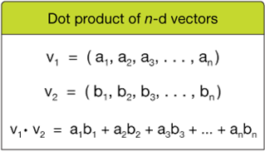
The scalar product
The scalar product of two vectors [a, b] and [c, d] is given by:
[a, b] . [c, d] = ac + bd
The scalar product is also known as the vector dot product

Slide 16
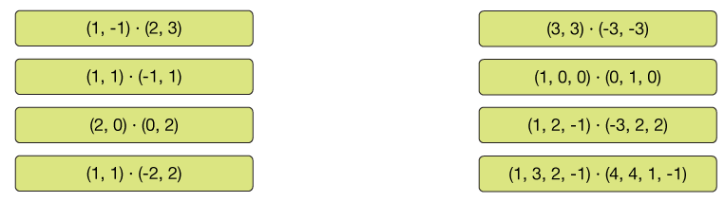
The scalar product
The scalar product of two vectors [a, b] and [c, d] is given by:
[a, b] . [c, d] = ac + bd
The scalar product is also known as the vector dot product

Slide 17
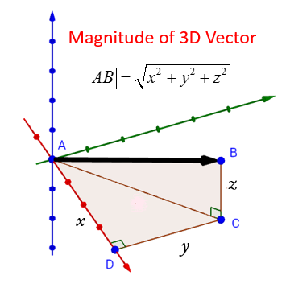
Length or Magnitude of a Vector
The dot-product of a vector with itself is the square of its length
..by means of Pythagoras’ theorem

Slide 18
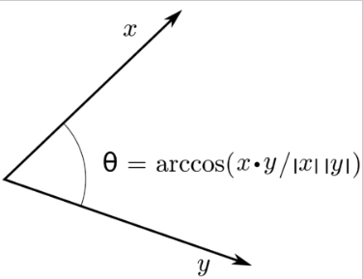
Angles between vectors
A dot product defines “length”
and also the angle between 2 vectors as per figure on the left
|x| is the length of vector x
x/|x| is a vector of length 1
(a “normalised” vector)

Slide 19
Scalar product and angles
[1, 0] . [0, 1] = 1∗0 + 0∗1 = 0
The scalar product is 0 meaning that cosθ = 0, i.e., the vectors are orthogonal (at right angles)
[1, 0] . [1, 1] = 1∗1 + 0∗1 = 1 = 1∗ √2 ∗ cosθ, hence cosθ = 1/√2 and therefore θ = 45°
θ | sinθ | cosθ | tanθ
0 | 0 | 1 | 0
30° | 1/2 | (√3)/2 | 1/√3
45° | 1/√2 | 1/√2 | 1
60° | (√3)/2 | 1/2 | √3
90° | 1 | 0 | ∞

Slide 20
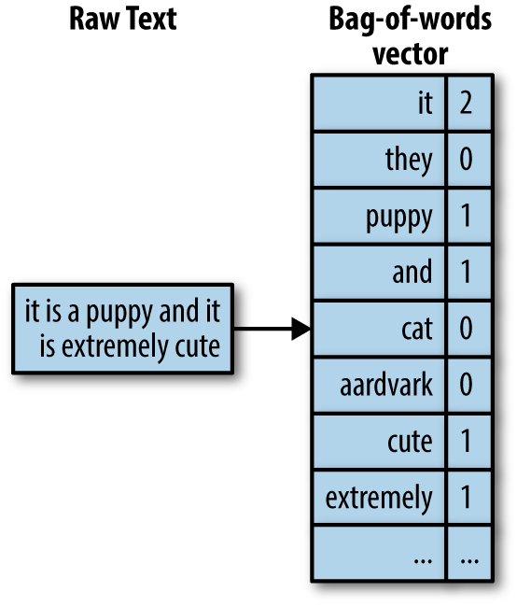
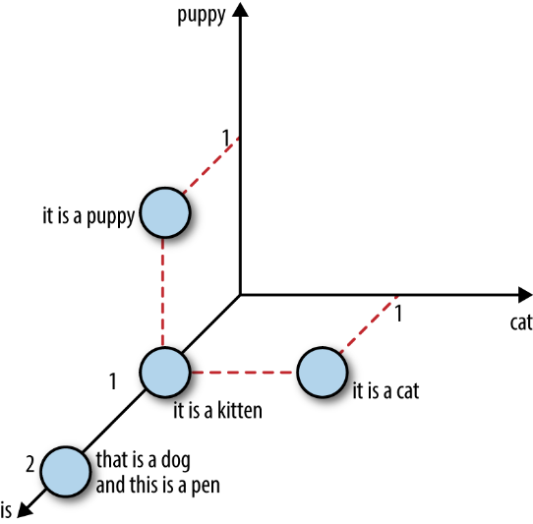
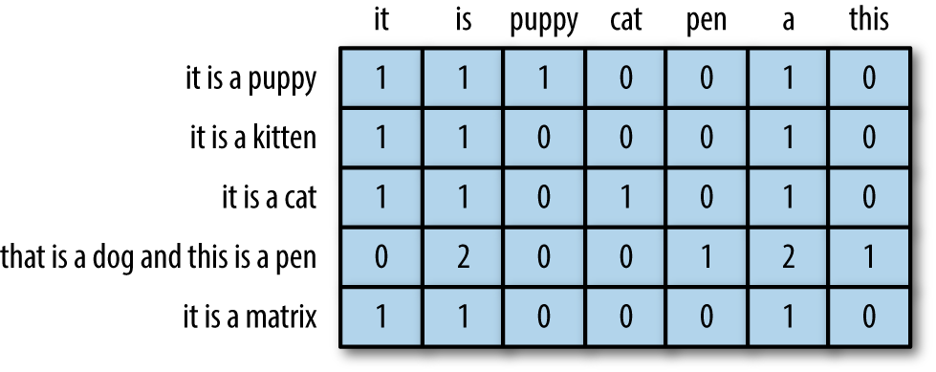
Example: Bag of Words Representation (for general objects use other property lists)
Left: a sentence represented by a “bag” / vector of words
Middle: Encodings of different vectors
Right: Representation of some encodings as vectors

Slide 21
Matrices and Transformations

Slide 22
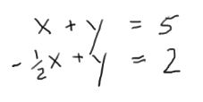
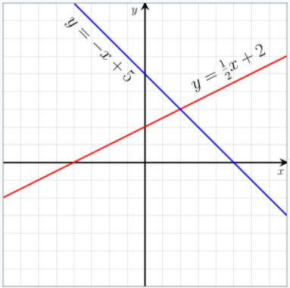
Linear Equations

Slide 23
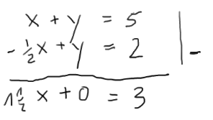
Linear Equations

Slide 24
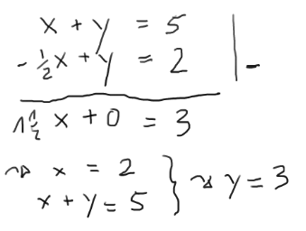
Linear Equations

Slide 25
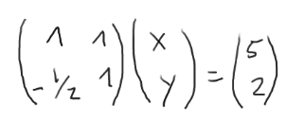
Linear Equations
Matrix Vector multiplication

Slide 26
2x2 matrices
A 2x2 matrix has the form
… where a, b, c and d are numbers
Generally you can have m x n matrices, where m is the number of rows, and n is the number of columns
a b
c d

Slide 27
Vectors as matrices
A vector [x, y] can be viewed as a 1x2 matrix
Sometimes we represent the same vector as a 2x1 matrix
x
y

Slide 28
Multiplying a vector by a matrix
Note the use of the scalar product, e.g.,
ax+by = [a,b] . [x,y]
a b
c d
x
y
ax + by
cx + dy
=
Matrix multiplication can be thought of as moving each point (in the plane) to another point in the plane
More generally, a 2-d transformation is any function which maps each point in the plane to another point in the plane
We’ll see that matrix multiplication allows us to represent many types of transformations.
Matrix algebra is thus of critical importance in Graphics & Games

Slide 29
Multiplying a vector by a matrix
3 5
0 1
2
3
3*2+5*3
0*2+1*3
21
3
=
=
3 5
0 1
0
3
3*0+5*3
0*0+1*3
15
3
=
=

Slide 30
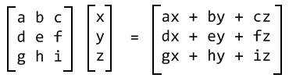
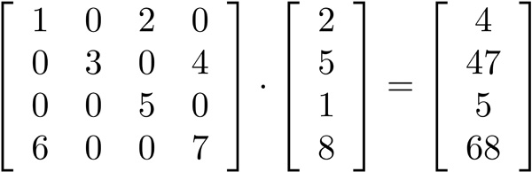
Matrix Vector Multiplication in higher dimensions
General scheme in 3 dimensions
4 dimensional Example with concrete numbers

Slide 31
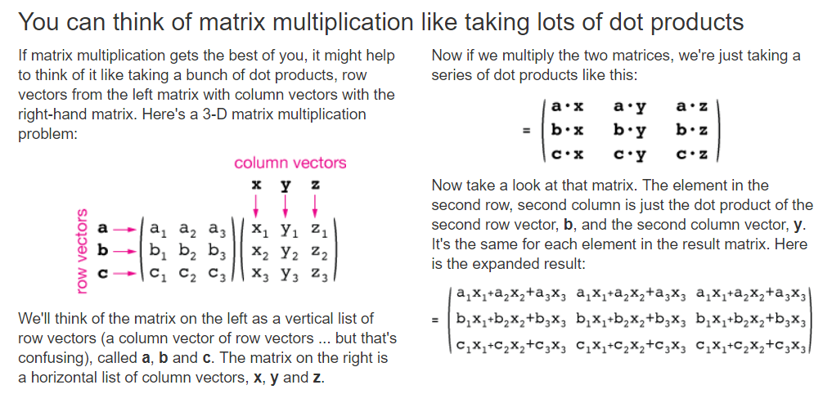

Slide 32
The identity matrix id₂
1 0
0 1
x
y
1x + 0y
0x + 1y
x
y
=
=
The identify matrix has no effect – it leaves each point where it was

Slide 33
Multiplying a matrix by a scalar
a b
c d
ka kb
kc kd
k
=

Slide 34
Multiplying a matrix by a matrix
u r
s t
a b
c d
ua+rc ub+rd
sa+tc sb+td
=
bottom left
bottom row
left column
[s, t] . [a, c] = sa+tc

Slide 35
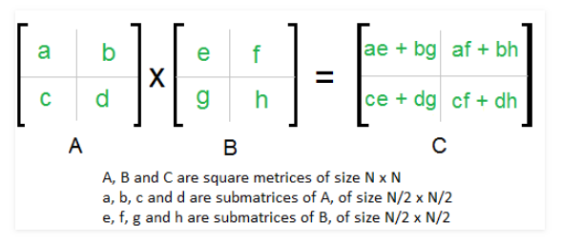
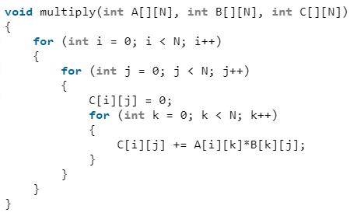
Matrix-Matrix Multiplication

Slide 36
Properties of matrix multiplication
If A, B and C are 2x2 matrices, then
(kA)v = k(Av) = A(kv)
A(v+w) = Av + Aw
A(Bv) = (AB)v
(AB)C = A(BC)
where
v and w are 2x1 vectors
k is a number/scalar

Slide 37
2x2 determinants
Given a 2x2 matrix A of the form
…… its determinant is given by
det(A) = ad – bc
a b
c d

Slide 38
Invertible matrices
A matrix A is invertible iff there is a matrix B such that
AB = BA = id (the identity matrix)
A matrix A is invertible iff det(A) ≠ 0, in which case its inverse is given by
a b
c d
d -b
-c a
A =
A⁻¹ = 1/λ
where λ = ad-bc = det(A)
A matrix is called singular iff its determinant is 0

Slide 39
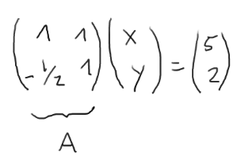
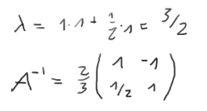
Linear Equations

Slide 40
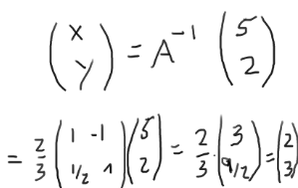
Linear Equations
In higher dimensions use libraries

Slide 41
Matrix inversion
If A is invertible, then so is A⁻¹ with
AA⁻¹ = A⁻¹A = id
(A⁻¹)⁻¹ = A
det(A⁻¹) = 1/det(A)
Av = w iff A⁻¹w = v
If multiplication by A represents a particular geometric transformation, then A⁻¹ represents the “inverse” transformation

Slide 42
Example
Consider the matrix A below
then det(A) = 2*1 - 2*1 = 0 and therefore A is not invertible.
To see that it can’t be invertible, take say the vectors v = [0, 1] and w = [1/2, 0]: then Av = Aw = [1, 1]. If A⁻¹ were to exist, it would have to map [1, 1] simultaneously onto both v and w
2 1
2 1
A =
2 1
2 1
x
y
2x + y
2x + y
=

Slide 43
Special Transformations

Slide 44
Translation
[h, u]
Translation … moving all points by a fixed amount in a fixed direction

Slide 45
Translation
Translation is easy … the distance and direction of the translation is given by a vector [h, u] and the movement is then achieved by mapping each point
[x, y] → [x, y] + [h, u] = [x+h, y+u]

Slide 46
Linear transformations
A transformation T is linear if – whenever v, w are vectors and k is a scalar – we have:
T(v+w) = T(v) + T(w)
T(kv) = kT(v)
Notice that if T(v) = Av, where A is a matrix, then T is linear
Conversely we will show that any linear transformation is represented by a matrix

Slide 47
Basis sets
In the 2-D plane, the two vectors [1, 0] and [0, 1] form a basis set, since
Neither can be expressed as a product of the other
Any other (2-D) vector v can be expressed as a linear combination
v = λ[1, 0] + μ[0,1]
E.g., if v = [2, 3] then λ = 2 and μ = 3

Slide 48
Deriving transformation matrices
Suppose T is a linear transformation, and we wish to find the relevant matrix A
To do this we need to know where T maps the basis vectors [1, 0] and [0, 1]
Suppose that T([1, 0]) = [a, c] and T([0, 1]) = [b, d], then
A =
a b
c d

Slide 49
Deriving transformation matrices
To see this, if v = [x, y] is any other vector, then
v = x[1, 0] + y[0, 1]
hence (since T is linear)
T(v) = xT([1, 0]) + yT([0, 1])
= x[a, c] + y[b, d] = [xa + yb, xc + yd]
a b
c d
x
y
=

Slide 50
Common linear transformations
Scaling … making an object bigger or smaller
Rotation
Projection
Reflection
Shearing

Slide 51
Scaling – by a factor of 1.5

Slide 52
Scaling
We can scale (from the origin) by a factor of k via
k 0
0 k
x
y
kx
ky
=

Slide 53
Rotation
28°

Slide 54
Counter-clockwise rotation by angle θ … about the origin
What is the impact on [1, 0]? It moves to [cosθ, sinθ]
1
θ
(0, 0)
(1, 0)

Slide 55
Counter-clockwise rotation by angle θ … about the origin
What is the impact on [0, 1]? It moves to [-sinθ, cosθ]
(0, 1)
1
θ
(0, 0)

Slide 56
Counter-clockwise rotation by angle θ … about the origin
The above rotation is thus represented by the matrix
cosθ -sinθ
sinθ cosθ
[1, 0] → [cosθ, sinθ] and [0,1] → [-sinθ, cosθ]
How would we represent rotation about some other point?

Slide 57
Projection onto the X axis
Sometimes we want to project an object onto a lower dimensional space.
E.g., a 3-D object has to be projected into 2-D to be represented on paper
E.g., A shadow represents a projection onto a 2-D space

Slide 58
Projection onto the X axis
Given a point [x, y], then
1 0
0 0
x
y
x
0
=
[1, 0] → [1, 0] and [0,1] → [0,0]
How would we represent projection onto the Y axis?

Slide 59
Reflection in the X axis

Slide 60
Reflection in the X axis
Given a point [x, y], then
1 0
0 -1
x
y
x
-y
=
[1, 0] → [1, 0] and [0,1] → [0,-1]
How would we represent reflection in the Y axis?

Slide 61
Horizontal shear
The horizontal movement of (1,1) is 1, whereas the horizontal movement of (0,2) and (2,2) is 2 … the horizontal movement is proportional to the height. Height is unaffected. Looking at the basis vectors: [1, 0] → [1, 0], [0, 1] → [1, 1]
(0,2)
(2,2)
(2,2)
(4,2)
✶
●
✶
●
(1,1)
(2,1)
⬥
⬥
(0,0)
(2,0)
(0,0)
(2,0)
Before shearing
After shearing

Slide 62
Horizontal shear
1 1
0 1
2
0
2
0
1 1
0 1
0
2
2
2
=
=
1 1
0 1
2
2
4
2
1 1
0 1
1
1
2
1
=
=
1 1
0 1
x
y
x+y
y
=

Slide 63
A general horizontal shear
1 m
0 1
x
y
x+my
y
=
[1, 0] → [1, 0] and [0,1] → [m,1]
The vertical displacement is unaffected; the horizontal displacement is moved by m times the vertical displacement

Slide 64
The transpose
Given a 2x2 matrix
then its transpose is given by
a b
c d
M =
a c
b d
Reflection about
the positive diagonal
M^{T} =

Slide 65
Orthogonal matrices
A matrix M is orthogonal if M⁻¹ = M^{T}
Recall that M⁻¹ represents the “inverse” transformation to M; computing the inverse is a common – but expensive – operation
If we know (in advance) that M is orthogonal we can cut down on the computational effort by computing the transpose instead
For example, reflection and rotation are orthogonal

Slide 66
Composition
If T1 and T2 are transformations we can combine them into a “compound” transformation by doing T1 and then T2
This would be denoted by T2 T1 so that
(T2 T1)(v) = T2(T1(v))

Slide 67
Matrix composition
Suppose A and B are matrices representing transformations T_{A} and T_{B} (respectively)
i.e., T_{A}(v) = Av and T_{B}(v) = Bv
Then (BA)(v) = B(Av) … and so the matrix BA represents the “compound” transformation T formed by executing T_{A} and then T_{B}, i.e.,
T_{(BA)} = T_{B} T_{A}

Slide 68
Composition - example
Consider the projection matrix
P =
then for any other matrix A =
we have that
1 0
0 0
a b
c d
a b
0 0
PA =

Slide 69
Composition - example
So for example if we take the rotation matrix
then
can be interpreted as a rotation followed by a projection (since it is equal to PR_{θ} where P is the projection matrix on the previous slide)
R_{θ} =
cosθ -sinθ
sinθ cosθ
cosθ -sinθ
0 0

Slide 70
Rotation about (a, b)
p’
The rotation maps the point
p to the point p’
(a,b)
θ
●
p
Let T be the translation that maps [a, b] to [0,0], i.e., T([x, y]) = [x-a, y-b]
Then: T(p) = r
r is mapped to r’ by applying R_{θ}
r’ is mapped to p’ by applying T⁻¹
Rotation about (a, b) is thus achieved by the compound transformation
T⁻¹ R_{θ} T
r’
θ
r

Slide 71
Eigenvectors and -values

Slide 72
Let A be an n times n square matrix, u a vector and lambda a scalar. If
u is called an Eigenvector of A and lambda an Eigenvalue.

Slide 73
Let A be an n times n square matrix, u a vector and lambda a scalar. If
u is called an Eigenvector of A and lambda an Eigenvalue.
In the direction of u the transformation A scales by a factor of lambda

Slide 74
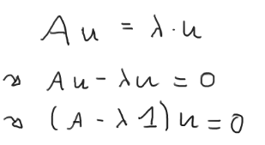

Eigenvalues
Eigenvalues are determined from the so-called characteristic polynomial

Slide 75
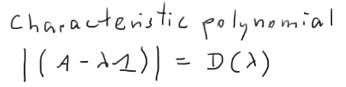
Eigenvalues
Eigenvalues are determined from the so-called characteristic polynomial

Slide 76


Eigenvalues
Eigenvalues are determined from the so-called characteristic polynomial
Example

Slide 77
Eigenvectors
Given the Eigenvalues the Eigenvectors can be computed from the definition
by solving the induced linear set of equations

Slide 78
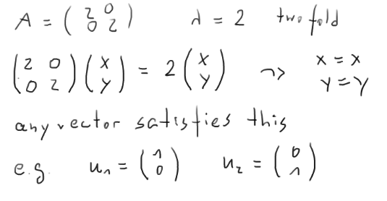
Eigenvectors Example
This is a degenerate case..

Slide 79
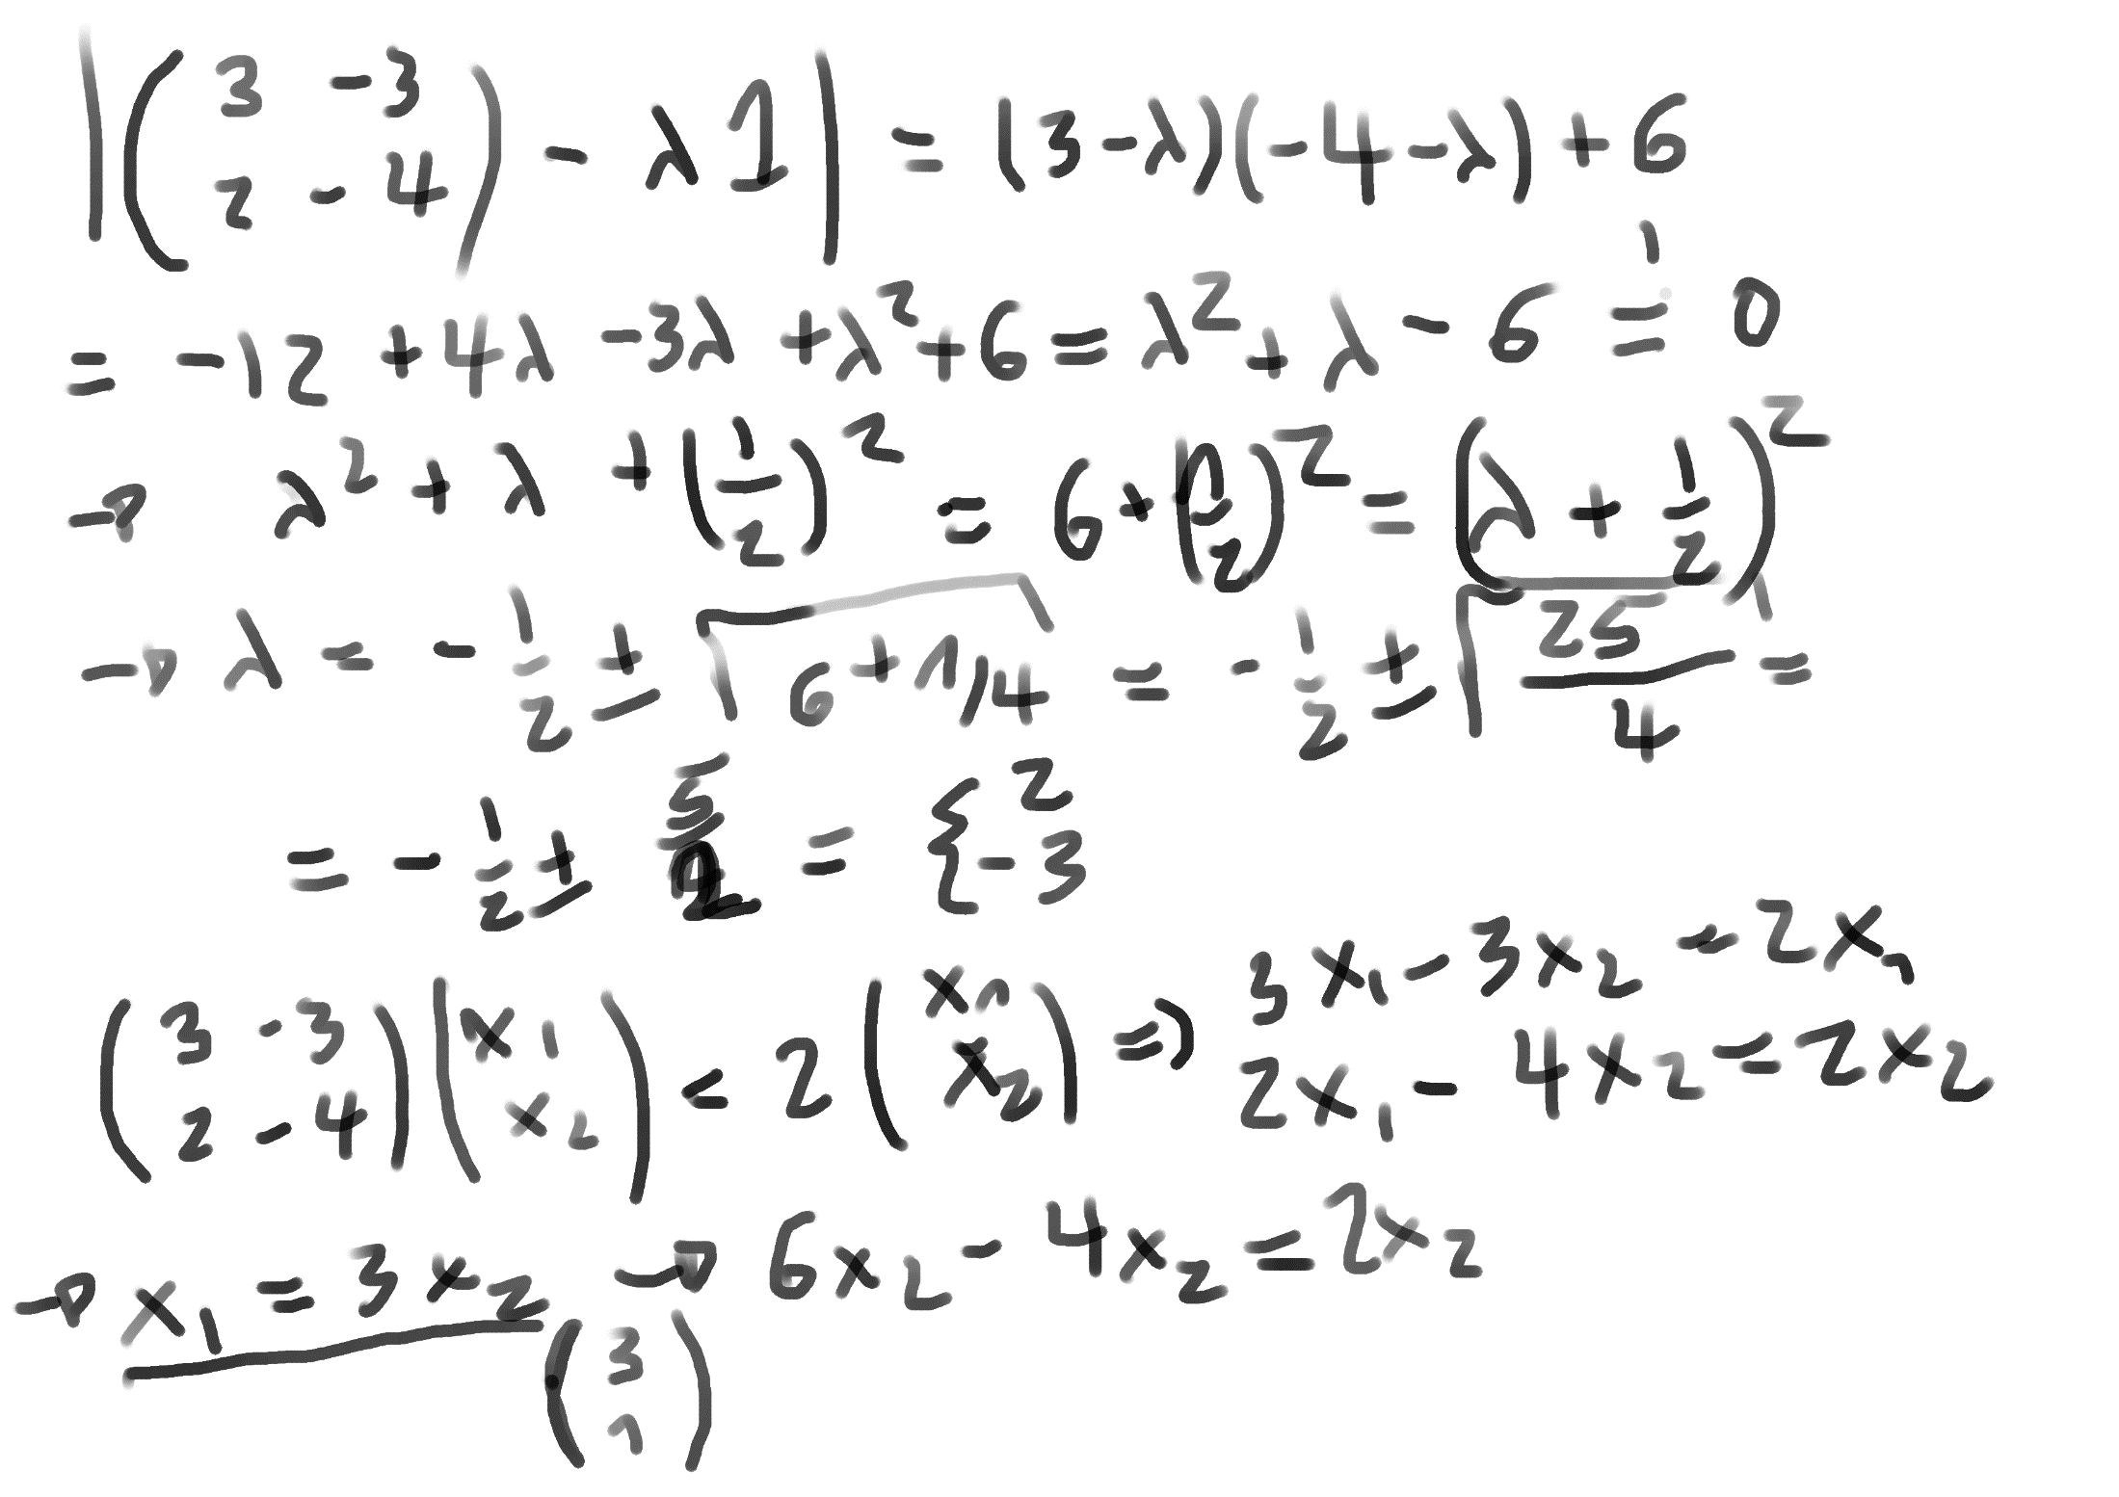
Generic Example

Slide 80
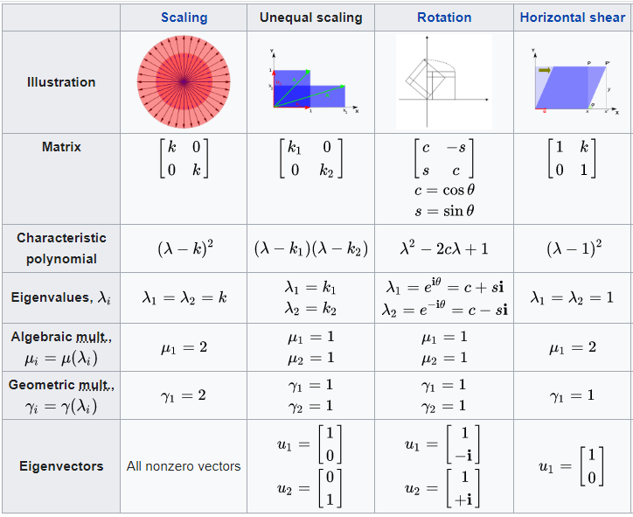
Eigenvalues and -vectors of common transformations

Slide 81
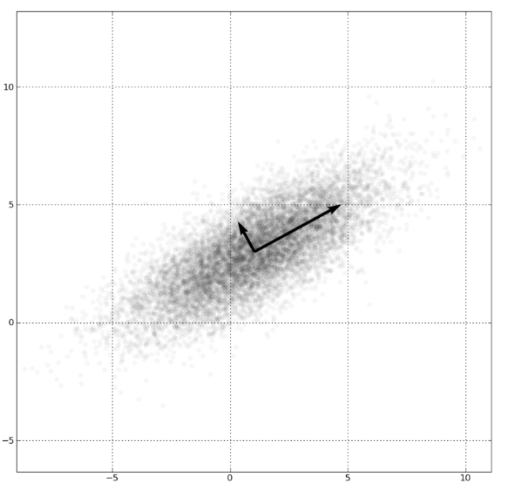
Application in BigData and Machine Learning
Given some data distribution
Find directions along which the data changes most
Data compression

Slide 82
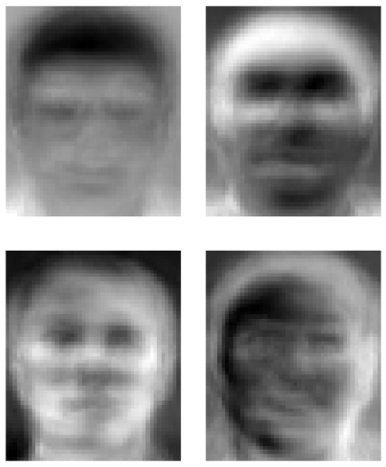
Eigenfaces (Sirovic&Kirby, Turk&Pentland)
Eigenfaces form base vectors
Any face can be described as a mix of Eigenfaces

Slide 83
Summary
Vectors and Matrices generalise numbers into higher dimensional spaces
Linear algebra is fundamental in many areas
Video games, VR, 3D rendering
Big data
Machine Learning
Highly optimised Matrix-Vector libraries are available including hardware acceleration

